Slide 1


STOP
Before using this template,
save a copy to your computer.
This is a shared template, any changes you make to the SharePoint versions will affect others.
©2024 Girl Scouts of Orange County. All Rights Reserved. Not for public distribution.

Slide 2

Service Unit Recognition Program Template Instructions:
Use the version that works best for your needs and remove or rearrange text blocks as needed.
Substitute and add your own photos to personalize it for your Service Unit.
Printing tip: Print on 8.5 x 11, double-sided flipping on the short end of the page.
These templates are pre-paginated and ready to be printed double-sided
on 8.5 x 11 paper, folded in half to a final size of 5.5 x 8.5
Templates included:
4 Page (Program Only) Print slides 2-3 only
8 Page (Adult Awards Only) Print slides 4-7 only
12 Page (Adult and Girl Awards) Print slides 8-13 only
Need additional support?
Reach out to your GSOC Volunteer Manager (Formerly Troop Support Specialist)
©2024 Girl Scouts of Orange County. All Rights Reserved. Not for public distribution.

Slide 3


Special Thanks
Service Unit
Recognition Event
Name Here
Name Here
Name Here
Name Here
Name Here
Name Here
Name Here
Honoring the accomplishments and contributions of our very own Girl Scouts and volunteers
September 30, 2024 | Service Unit 0000
Notes:
Change date and Service Unit #

Slide 4

THE GIRL SCOUT PROMISE
On my honor, I will try
to serve God* and my country,
to help people at all times,
and to live by the Girl Scout Law.
THE GIRL SCOUT LAW
I will do my best to be
honest and fair,
friendly and helpful,
considerate and caring,
courageous and strong, and
responsible for what I say and do
and to
respect myself and others,
respect authority,
use resources wisely,
make the world a better place,
and to be a sister to every Girl Scout.
*Members may substitute for the word God
in accordance with their own spiritual beliefs.
Adult Awards
Numeral Guard Pins
Orange Owl
Spotlight Award
Shining Star Award
Volunteer of Excellence
President’s Award
Opening Doors Award
Appreciation Pin
Honor Pin
Thanks Badge I
Thanks Badge II
Girl Awards
Ten Year Award
Graduating Girl Scouts
Bridge to Adult Girl Scouts
Faith Awards
My Promise, My Faith | OC Faith Mentor Award
Journey Summit Award
Mentoring Awards
Junior Aide | LiA | CIT | VIT
Girl Scout High Awards
Bronze | Silver | Gold
Juliette Low Spirit of Girl Scouting
Outstanding Senior
Meritorious Awards
Bronze Cross | Medal of Honor
1 Service Unit Recognition Event
Girl Scouts of Orange County 2

Slide 5
Special Thanks
Service Unit
Recognition Event
Name Here
Name Here
Name Here
Name Here
Name Here
Name Here
Name Here
Honoring the accomplishments and contributions of our very own Girl Scouts and volunteers
September 30, 2024 | Service Unit 0000
Notes:
Change date and Service Unit #

Slide 6
THE GIRL SCOUT PROMISE
On my honor, I will try
to serve God* and my country,
to help people at all times,
and to live by the Girl Scout Law.
THE GIRL SCOUT LAW
I will do my best to be
honest and fair,
friendly and helpful,
considerate and caring,
courageous and strong, and
responsible for what I say and do
and to
respect myself and others,
respect authority,
use resources wisely,
make the world a better place,
and to be a sister to every Girl Scout.
*Members may substitute for the word God
in accordance with their own spiritual beliefs.
Honor Pin
Recognizes an individual’s exemplary service in support of delivering the Girl Scout Leadership Experience, which has had a measurable impact on two or more geographic areas of service.
First/Last Name
First/Last Name
First/Last Name
First/Last Name
First/Last Name
First/Last Name
First/Last Name
First/Last Name
Thanks Badge I
The Thanks Badge is the highest volunteer award given in Girl Scouting reserved for individual members whose service to the organization has been truly outstanding and is significantly over and above the call of duty.
First/Last Name
First/Last Name
First/Last Name
Thanks Badge II
The Thanks Badge II recognizes members who have already received the Thanks Badge I and continue to contribute in extraordinary ways that benefits the entire Council or the entire Girl Scout movement.
First/Last Name
1 Service Unit Recognition Event
Girl Scouts of Orange County 6

Slide 7
President’s Award
Adult Awards
Recognizes the efforts of a community team or program delivery team for moving its assigned area or audience toward the achievement of the council’s goals during a fiscal or membership year.
Numeral Guard Pin ……………………..... 3
Orange Owl ……………………………….. 3
Spotlight Award …………………………. 4
Shining Star Award ….…………………… 4
Volunteer of Excellence ……………..…… 4
President’s Award ……………………….... 5
Opening Doors Award …………………… 5
Appreciation Pin …………………..……… 5
Honor Pin …………………………………. 6
Thanks Badge I ……………………………. 6
Thanks Badge II …………………………... 6
Committee Name
First/Last Name
First/Last Name
First/Last Name
First/Last Name
First/Last Name
First/Last Name
Opening Doors Award
Recognizes an individual who intentionally introduced Girl Scouting to an otherwise unserved or under-served area or group.
First/Last Name
Appreciation Pin
Recognizes an individual’s exemplary service in support of delivering the Girl Scout Leadership Experience, which has had a measurable impact on one geographic area of service.
First/Last Name
First/Last Name
First/Last Name
First/Last Name
First/Last Name
First/Last Name
5 Service Unit Recognition Event
Girl Scouts of Orange County 2

Slide 8
Numeral Guard Pins
Spotlight Award
Numerals show the total number of years of registered membership, both as a girl and an adult, in any Girl Scout/Girl Guide organization.
Recognizes an individual who previously received the Orange Owl and continues to give outstanding service to the Service Unit.
15 Years
First/Last Name
First/Last Name
20 Years
First/Last Name
First/Last Name
25 Years
First/Last Name
First/Last Name
30 Years
First/Last Name
First/Last Name
35 Years
First/Last Name
First/Last Name
40 Years
First/Last Name
First/Last Name
45 Years
First/Last Name
First/Last Name
50 Years
First/Last Name
First/Last Name
First/Last Name
First/Last Name
First/Last Name
First/Last Name
First/Last Name
First/Last Name
First/Last Name
First/Last Name
Shining Star Award
Recognizes members or non-members who have assisted a troop or troops or a Service Unit without an official volunteer title or role.
First/Last Name
First/Last Name
First/Last Name
First/Last Name
First/Last Name
First/Last Name
First/Last Name
First/Last Name
Orange Owl
Volunteer of Excellence
Recognizes an individual who has consistently given outstanding service to Girl Scouting in their local Girl Scout community.
Recognizes an individual who has contributed outstanding service while partnering directly with girls in any pathway to implement the Girl Scout Leadership Experience OR who has contributed outstanding service in support of the council’s mission delivery to girl and adult members.
First/Last Name
First/Last Name
First/Last Name
First/Last Name
First/Last Name
First/Last Name
First/Last Name
First/Last Name
First/Last Name
First/Last Name
First/Last Name
First/Last Name
First/Last Name
First/Last Name
First/Last Name
First/Last Name
3 Service Unit Recognition Event
Girl Scouts of Orange County 4

Slide 9
Special Thanks
Service Unit
Recognition Event
Name Here
Name Here
Name Here
Name Here
Name Here
Name Here
Name Here
Honoring the accomplishments and contributions of our very own Girl Scouts and volunteers
September 30, 2024 | Service Unit 0000
Notes:
Change date and Service Unit #

Slide 10
THE GIRL SCOUT PROMISE
On my honor, I will try
to serve God* and my country,
to help people at all times,
and to live by the Girl Scout Law.
THE GIRL SCOUT LAW
I will do my best to be
honest and fair,
friendly and helpful,
considerate and caring,
courageous and strong, and
responsible for what I say and do
and to
respect myself and others,
respect authority,
use resources wisely,
make the world a better place,
and to be a sister to every Girl Scout.
*Members may substitute for the word God
in accordance with their own spiritual beliefs.
Juliette Low Spirit of Girl Scouting
The Juliette Low Spirit of Girl Scouting Award recognizes graduating 12th grade Girl Scout Ambassadors who demonstrate significant involvement in Girl Scout activities (including program, service, and advocacy). These young women exemplify the spirit of Girl Scouting and like Juliette Low, the founder of Girl Scouting in the U.S., they are eager to experience and share the Girl Scout spirit with others.
First/Last Name
Troop Number
First/Last Name
Troop Number
Outstanding Senior Girl Scout
The Outstanding Senior Girl Scout Recognition honors graduating 12th grade Girl Scout Ambassadors who live out the Girl Scout Promise and Law and demonstrate excellence through involvement and leadership in school, community, and Girl Scout activities. Recipients of this award represent the Girl Scout Promise and Law. Their names are listed on a perpetual plaque at Council Headquarters.
First/Last Name
Troop Number
First/Last Name
Troop Number
Meritorious Awards
Bronze Cross
First/Last Name
Medal of Honor
First/Last Name
1 Service Unit Recognition Event
Girl Scouts of Orange County 10

Slide 11
Girl Scout High Awards
Adult Awards
Bronze Award
Numeral Guard Pins
Orange Owl
Spotlight Award
Shining Star Award
Volunteer of Excellence
President’s Award
Opening Doors Award
Appreciation Pin
Honor Pin
Thanks Badge I
Thanks Badge II
Project Name
Troop Number
First/Last Name
First/Last Name
First/Last Name
First/Last Name
First/Last Name
First/Last Name
Project Name
Troop Number
First/Last Name
First/Last Name
First/Last Name
First/Last Name
First/Last Name
First/Last Name
Silver Award
Project Name
Troop Number
First/Last Name
First/Last Name
First/Last Name
Girl Awards
Project Name
Troop Number
First/Last Name
First/Last Name
First/Last Name
Ten Year Award
Graduating Girl Scouts
Bridge to Adult Girl Scouts
Faith Awards
My Promise, My Faith | OC Faith Mentor Award
Journey Summit Award
Mentoring Awards
Junior Aide | LiA | CIT | VIT
Girl Scout High Awards
Bronze | Silver | Gold
Juliette Low Spirit of Girl Scouting
Outstanding Senior
Meritorious Awards
Bronze Cross | Medal of Honor
Gold Award
Project Name
Troop Number
First/Last Name
Project Name
Troop Number
First/Last Name
Project Name
Troop Number
First/Last Name
Project Name
Troop Number
First/Last Name
Project Name
Troop Number
First/Last Name
Project Name
Troop Number
First/Last Name
9 Service Unit Recognition Event
Girl Scouts of Orange County 2

Slide 12
Numeral Guard Pins
Faith Awards
Numerals show the total number of years of registered membership, both as a girl and an adult, in any Girl Scout/Girl Guide organization.
My Promise, My Faith Pins
First/Last Name
First/Last Name
First/Last Name
First/Last Name
First/Last Name
First/Last Name
OC Faith Mentor
First/Last Name
First/Last Name
First/Last Name
First/Last Name
First/Last Name
First/Last Name
15 Years
First/Last Name
First/Last Name
20 Years
First/Last Name
First/Last Name
25 Years
First/Last Name
First/Last Name
30 Years
First/Last Name
First/Last Name
35 Years
First/Last Name
First/Last Name
40 Years
First/Last Name
First/Last Name
45 Years
First/Last Name
First/Last Name
50 Years
First/Last Name
First/Last Name
Journey Summit Awards
First/Last Name
First/Last Name
First/Last Name
First/Last Name
First/Last Name
First/Last Name
First/Last Name
First/Last Name
Mentoring Awards
Orange Owl
Junior Aide
First/Last Name
First/Last Name
First/Last Name
First/Last Name
Counselor in Training
First/Last Name
First/Last Name
First/Last Name
First/Last Name
Leader in Action
First/Last Name
First/Last Name
First/Last Name
First/Last Name
Volunteer in Training
First/Last Name
First/Last Name
First/Last Name
First/Last Name
Recognizes an individual who has consistently given outstanding service to Girl Scouting in their local Girl Scout community.
First/Last Name
First/Last Name
First/Last Name
First/Last Name
First/Last Name
First/Last Name
First/Last Name
First/Last Name
3 Service Unit Recognition Event
Girl Scouts of Orange County 8

Slide 13
Ten Year Award
Spotlight Award
For Girl Scouts under the age of 18, this pin is awarded to those who have spent a decade on their Girl Scout Leadership Experience.
Recognizes an individual who previously received the Orange Owl and continues to give outstanding service to the Service Unit.
First/Last Name
First/Last Name
First/Last Name
First/Last Name
First/Last Name
First/Last Name
First/Last Name
First/Last Name
First/Last Name
First/Last Name
First/Last Name
First/Last Name
First/Last Name
First/Last Name
First/Last Name
First/Last Name
First/Last Name
First/Last Name
First/Last Name
First/Last Name
Shining Star Award
Graduating Girl Scouts
Recognizes members or non-members who have assisted a troop or troops or a Service Unit without an official volunteer title or role.
First/Last Name
First/Last Name
First/Last Name
First/Last Name
First/Last Name
First/Last Name
First/Last Name
First/Last Name
First/Last Name
First/Last Name
First/Last Name
First/Last Name
First/Last Name
First/Last Name
First/Last Name
First/Last Name
First/Last Name
First/Last Name
First/Last Name
First/Last Name
First/Last Name
First/Last Name
Volunteer of Excellence
Bridge to Adult Girl Scouts
Recognizes an individual who has contributed outstanding service while partnering directly with girls in any pathway to implement the Girl Scout Leadership Experience OR who has contributed outstanding service in support of the council’s mission delivery to girl and adult members.
First/Last Name
First/Last Name
First/Last Name
First/Last Name
First/Last Name
First/Last Name
First/Last Name
First/Last Name
First/Last Name
First/Last Name
First/Last Name
First/Last Name
First/Last Name
First/Last Name
First/Last Name
First/Last Name
First/Last Name
First/Last Name
First/Last Name
First/Last Name
First/Last Name
First/Last Name
7 Service Unit Recognition Event
Girl Scouts of Orange County 4

Slide 14
President’s Award
Honor Pin
Recognizes the efforts of a community team or program delivery team for moving its assigned area or audience toward the achievement of the council’s goals during a fiscal or membership year.
Recognizes an individual’s exemplary service in support of delivering the Girl Scout Leadership Experience, which has had a measurable impact on two or more geographic areas of service.
Committee Name
First/Last Name
First/Last Name
First/Last Name
First/Last Name
First/Last Name
First/Last Name
First/Last Name
First/Last Name
First/Last Name
First/Last Name
First/Last Name
First/Last Name
First/Last Name
First/Last Name
Thanks Badge I
Opening Doors Award
The Thanks Badge is the highest volunteer award given in Girl Scouting reserved for individual members whose service to the organization has been truly outstanding and is significantly over and above the call of duty.
Recognizes an individual who intentionally introduced Girl Scouting to an otherwise unserved or under-served area or group.
First/Last Name
First/Last Name
First/Last Name
First/Last Name
Appreciation Pin
Thanks Badge II
Recognizes an individual’s exemplary service in support of delivering the Girl Scout Leadership Experience, which has had a measurable impact on one geographic area of service.
The Thanks Badge II recognizes members who have already received the Thanks Badge I and continue to contribute in extraordinary ways that benefits the entire Council or the entire Girl Scout movement.
First/Last Name
First/Last Name
First/Last Name
First/Last Name
First/Last Name
First/Last Name
First/Last Name
5 Service Unit Recognition Event
Girl Scouts of Orange County 6

Slide 15
















Palatino Brand Asset Library. Change shape color in “Shape Format” options. Resize shapes proportionally.
Do not stretch or outline shapes.
UNDER NO CIRCUMSTANCES SHOULD YOU APPLY
TEXT ON TOP OF OR WITHIN THE TREFOIL SHAPE.
©2024 Girl Scouts of Orange County. All Rights Reserved. Not for public distribution.

Slide 16









Palatino Brand Asset Library. Change icon line color in “Shape Format” options. Resize shapes proportionally.
Do not stretch, outline, or fill-in assets.
©2024 Girl Scouts of Orange County. All Rights Reserved. Not for public distribution.

Slide 17
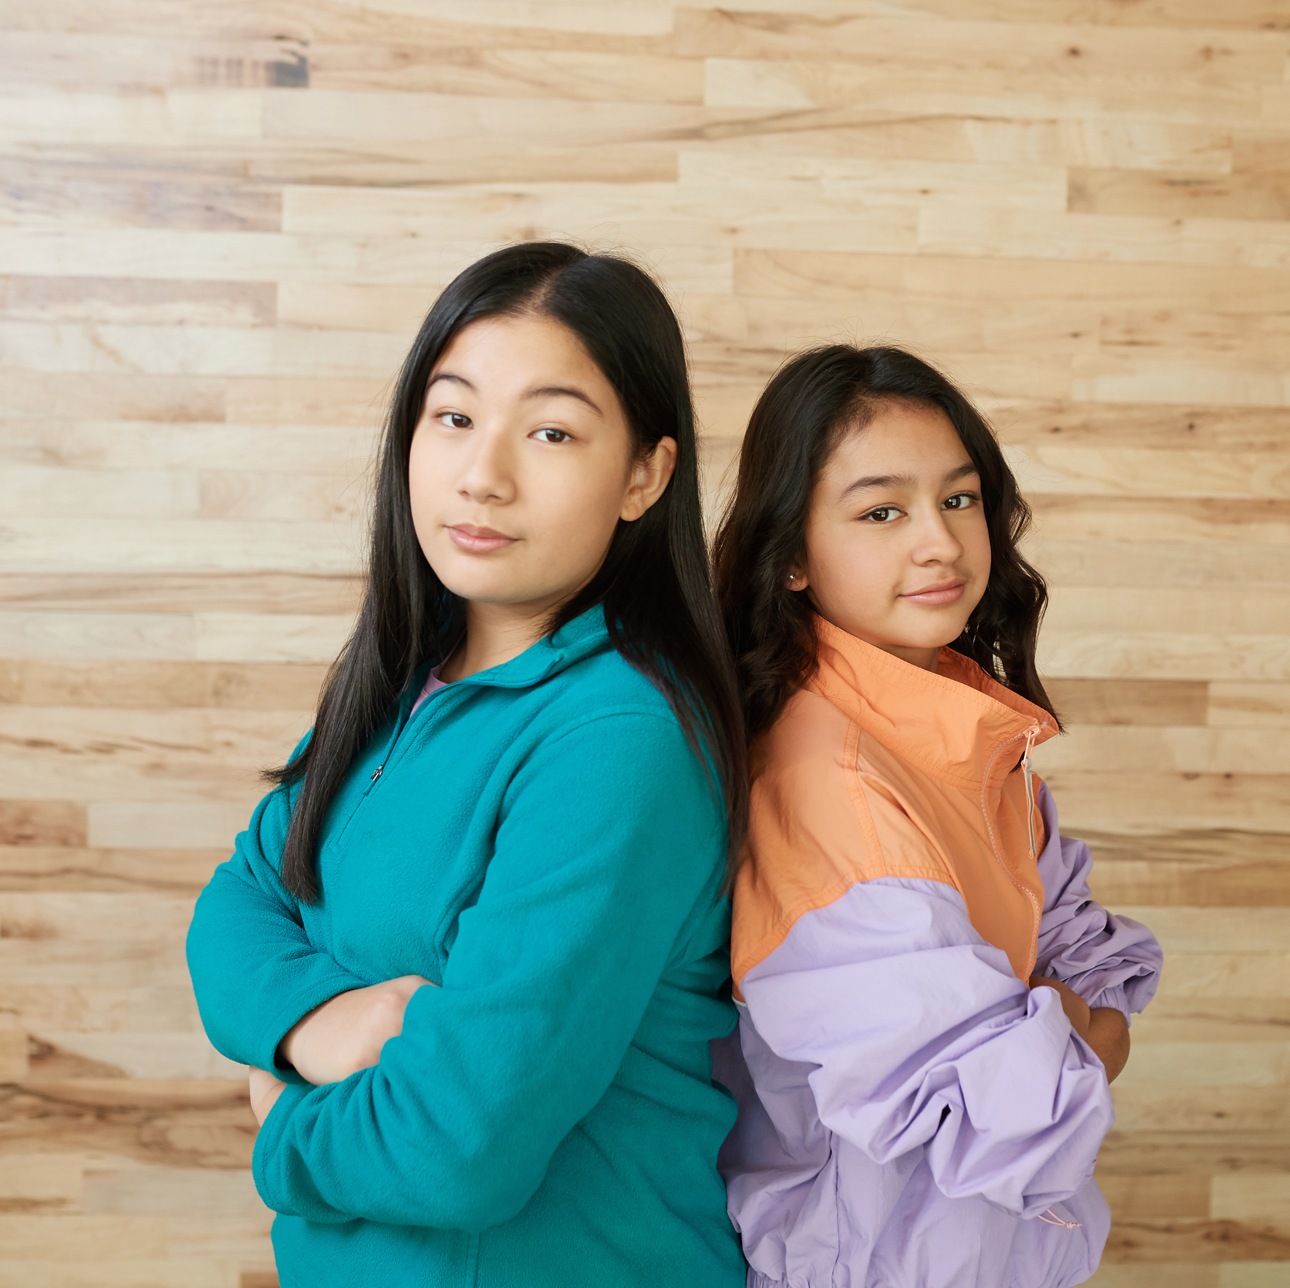
Palatino Brand Asset Library. Change frame color in “Shape Format” options. Resize frames proportionally.
Do not stretch or outline frames.
©2024 Girl Scouts of Orange County. All Rights Reserved. Not for public distribution.

